Slide 1
Business insurance 101
Christina Beeke

Slide 2
Business insurance 101
Can cover
the business
the employees (and their families)
injuries on the job
injuries off the job
Sickness
*a motor vehicle accident
What it doesn’t cover
Travel
Illegal activities (breaking the law)

Slide 3
What may be available for a small business
What will be discussed in detail
PFML (Paid Family/Med Leave)
Workers Compensation
Disability
Business Overhead
Life (Whole and Term)
Other options
Errors and Omissions
Accident
Critical Illness
Travel

Slide 4
Paid Family and Medical Leave (PFML) information
Not everyone is eligible, some exclusions apply (commission based)
You must opt in, at or after 18 years of age
The rates vary as a percentage of annual income
Minimum is $6,300 in the previous 4 quarters prior to the event
Sample events:
Birth, Death, Care of a family member, Planned Surgery, Unplanned Sickness or injury of self? Or family member (in some states)

Slide 5
Paid Family and Medical Leave (PFML) ELIGIBILITY
Most Massachusetts employees are eligible for up to 26 weeks of combined family and medical leave per benefit year, may include:
Up to 20 weeks of paid medical leave to manage a personal serious health condition
Up to 12 weeks of paid family leave to care for a family member or to bond with a child
Up to 26 weeks of paid family leave to care for a family member who is a member of the armed forces
You can take more than one kind of Family and Medical Leave in a benefit year, but the maximum amount of leave you can take in a benefit year is 26 weeks.

Slide 6
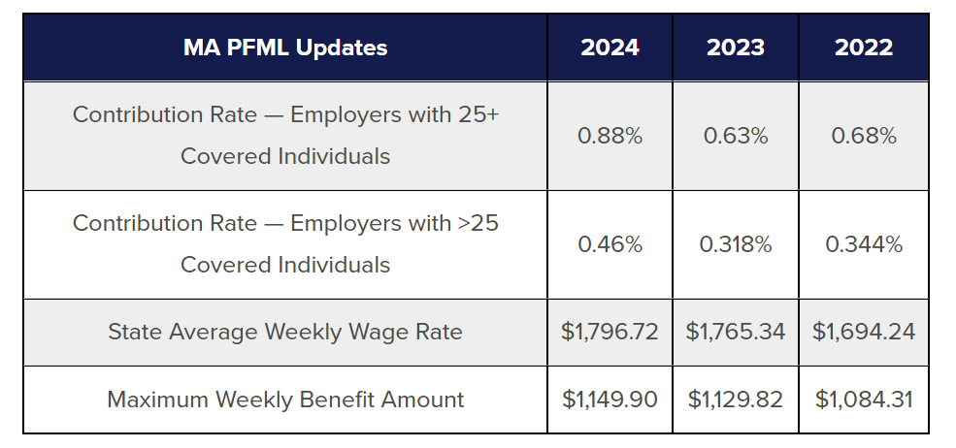
Paid Family and Medical Leave (PFML) Tax Rate (MA)

Slide 7
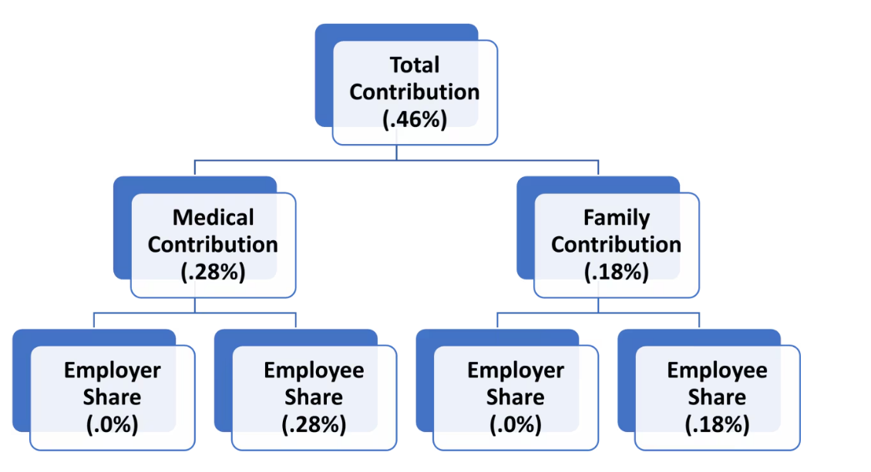
Paid Family and Medical Leave (PFML) Contribution breakdown

Slide 8
Paid Family and Medical Leave (PFML) self-employed opt in
If you are self-employed and reside in the Commonwealth of Massachusetts, you can sign up for the PFML program through MassTaxConnect.
Your PFML enrollment will begin on the date you opt in through MassTaxConnect. After you enroll in the program, you'll be required to stay enrolled for at least 3 years. During this time, you'll have to file quarterly earnings reports and make the full quarterly contribution payments for both family and medical leave based on your earnings.

Slide 9
Employer required offering: Worker compensation
Employees who are injured during the course of employment, or who suffer from work-related mental or emotional disabilities, as well as occupational diseases, are eligible for workers' compensation benefits in Massachusetts. These benefits include medical and hospital services, medically necessary equipment and prescribed drugs, weekly compensation for lost income during the period the employee cannot work, and vocational and rehabilitation services.
Employers may or may not have coverage for self, be sure to inquire if YOU (owner) are covered as an employee in addition to employees.

Slide 10
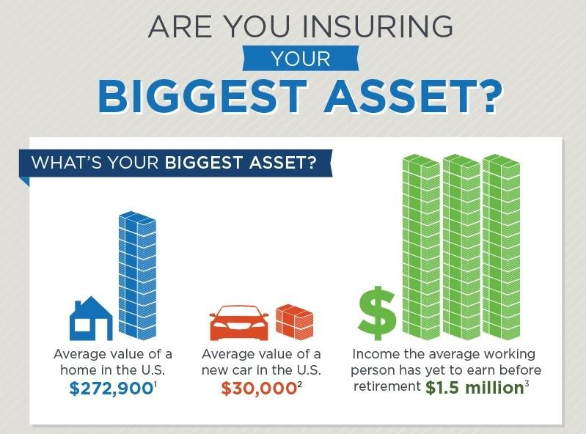
What Is your biggest asset?
Your income

Slide 11
Insure your assets through disability coverage

Slide 12
Disability coverage (short or long-term)
Covers you when injured off the job or sickness
Covers you and your family to continue living the lifestyle you are accustom to
Elimination period(s) apply – will pay when out of work X days
When you get injured or ill, the bills don’t stop
MUG Expenses: Mortgage Utilities, Groceries
What you forget: Auto Ins and Payment, Health Insurance, Life Insurance, Credit Card, Convenience services
*On the job rider extra coverage available for those who may need it

Slide 13
Option: Short-term disability insurance
Short-Term Disability Insurance can help provide income protection while you are unable to work due to a covered sickness, injury or mental health condition so you can focus on recovery.
Varied coverage duration and elimination periods as well as payout amounts

Slide 14
Aflac Offers Short-Term Disability Insurance (min. 3 employees)
Income based
Guaranteed-issue option, meaning you may be able to skip the medical exam and still receive coverage.
Choose 3 or 6 months of coverage
Aflac requires 3 employees and thru Payroll Deduction
Up to Age 65 years old (ends month of 65th birthday)
Age 18 to 49 years old – buy in eligible
Age 50 to 64 years old – buy in eligible

Slide 15
Option: long-term disability insurance
Long-Term Disability Insurance can help provide income protection while you are unable to work due to a covered sickness, injury or mental health condition so you can focus on recovery.
Employee purchased benefit (out of pocket)
Extended application process, with extensive verification

Slide 16
Option: long-term disability insurance
Varied coverage duration and elimination periods as well as payout amounts
But will start when an extended elimination period is complete (30, 90 or 180 days, 1 year)
Extended elimination (Longer elimination period) – lower premium
Extended coverage – increased premium
Longer coverage periods 1, 2, 5 year or up to age 65 vs months

Slide 17
Business overhead
Covers expenses for the business: rent, payroll/salary, taxes
Paid to the business for operations based on insured amount
Self employed, with or without employees
Limited time period coverage
Must opt in before needed

Slide 18
Whole Life insurance
Lifetime** coverage as long as premium are paid
Tax-deferred growth of policy cash values
Liquidity through policy loans, which can help supplement retirement income, college costs and more
A stable financial asset on your balance sheet that will never lose value year to year
Income tax-free death benefit

Slide 19
Term Life insurance
The lowest initial premium to obtain the highest death benefit
Ideal for those who need coverage for a specific period of time
Option to convert to whole life insurance later without evidence of insurability
Income tax-free death benefit*

Slide 20
Return of premium Life insurance
Issue age from 18 to 60
20 years, 30 years or to age 65
Death benefits: $50,000 to $500,000
At the end of the Term, you decide what option is best:
Option A: Guaranteed Cash Refund
Option B: Guaranteed Reduced Paid up Life Insurance
Option C: Guaranteed Extended Term Insurance

Slide 21
Errors & Omissions
Professional Liability insurance, also known as Errors and Omissions (E&O) coverage, is designed to protect your business against claims that professional advice or services you provided caused a customer financial harm due to actual or alleged mistakes or a failure to perform a service.
Errors or oversights
Failure to deliver
Professional negligence
Breach of contract

Slide 22
Accident
24 Hour Coverage
Simple to Major Accident Covered
Will pay on top of other coverage ( Car, Workers Comp)
The money comes to you, based on service received
Aflac thru Payroll or Direct

Slide 23
critical illness
Cancer
5 year look back
Simple claim process only need a positive pathology report
Heart/Stroke
Lump Sum option available: 10K to 100K
Available from 18 to 69 years old (based on youngest spouse)
Direct

Slide 24
Travel insurance
Single Trip
Great for families traveling 1 time during the year
Annual Coverage
Unlimited trips
Each trip up to 45 days
Same rates for age 18 to 99 years old
Coverage option: 3K , 5K , 7500 , 10K and more

Slide 25
There are many insurance options: How to make the decision to purchase
Personal Decision
Industry and person specific
Repetitive use injury: LMT, Hairdresser, Chef
Lifestyle – cyclist, skier, athlete, auto accident (Option: Accident Coverage)
Risk tolerance

Slide 26
Q&A

Slide 27
thank you
Christina Beeke
413-977-6016
cbeeke1@gmail.com

